Slide 1
Loaders and Linkers
Module-4

Slide 2
Loader Schemes
1.Compile and Go Loaders
2. General Loader Scheme
3. Absolute Loaders
4. Subroutine Linkages
5. Relocating Loaders
6. Direct Linking Loaders
7. Other Loader Schemes:
a) Dynamic Loading
b) Dynamic Linking

Slide 3
Compile and go loader
In this type of loader, the instruction is read line by line, its machine code is obtained and it is directly put in the main memory at some known address.

Slide 4
Compile and go loader
In this type of loader, the instruction is read line by line, its machine code is obtained and it is directly put in the main memory at some known address.
The assembler runs in one part of memory and the assembled machine instructions and data is directly put into their assigned memory locations.

Slide 5
Compile and go loader
In this type of loader, the instruction is read line by line, its machine code is obtained and it is directly put in the main memory at some known address.
The assembler runs in one part of memory and the assembled machine instructions and data is directly put into their assigned memory locations.
After completion of assembly process, assign starting address of the program to the location counter.

Slide 6
Compile and go loader
In this type of loader, the instruction is read line by line, its machine code is obtained and it is directly put in the main memory at some known address.
That means the assembler runs in one part of memory and the assembled machine instructions and data is directly put into their assigned memory locations.
After completion of assembly process, assign starting address of the program to the location counter.
This loading scheme is also called as “assemble and go”.

Slide 7
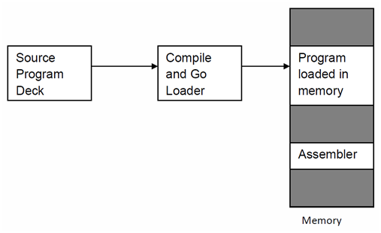
Compile and go loader

Slide 8
Compile and go loader
Advantage:
Easy to implement
Assembler runs in one part of memory and assembled instructions are directly loaded into core
No extra procedures are involved

Slide 9
Compile and go loader
Disadvantage:
Wastage of memory as assembler and loader both occupies memory space

Slide 10
Compile and go loader
Disadvantage:
Wastage of memory as assembler and loader both occupies memory space
Time consuming process as no production of object file

Slide 11
Compile and go loader
Disadvantage:
Wastage of memory as assembler and loader both occupies memory space
Time consuming process as no production of object file
It can’t handle multiple source languages and multiple source programs

Slide 12
Compile and go loader
Disadvantage:
Wastage of memory as assembler and loader both occupies memory space
Time consuming process as no production of object file
It can’t handle multiple source languages and multiple source programs
For a programmer it is very difficult to make an orderly modulator program and also it becomes difficult to maintain such program, and the “compile and go” loader cannot handle such programs.

Slide 13
Compile and go loader
Disadvantage:
Wastage of memory as assembler and loader both occupies memory space
Time consuming process as no production of object file
It can’t handle multiple source languages and multiple source programs
For a programmer it is very difficult to make an orderly modulator program and also it becomes difficult to maintain such program, and the “compile and go” loader cannot handle such programs.
Execution time is more

Slide 14
Absolute Loader
Absolute loader is a kind of loader in which relocated object files are created.

Slide 15
Absolute Loader
Absolute loader is a kind of loader in which relocated object files are created.
Loader accepts these files and places them at specified locations in the memory.

Slide 16
Absolute Loader
Absolute loader is a kind of loader in which relocated object files are created.
Loader accepts these files and places them at specified locations in the memory.
This type of loader is called absolute because no relocation information is needed

Slide 17
Absolute Loader
Absolute loader is a kind of loader in which relocated object files are created.
Loader accepts these files and places them at specified locations in the memory.
This type of loader is called absolute because no relocation information is needed
This relocation information is obtained from the programmer or assembler.

Slide 18
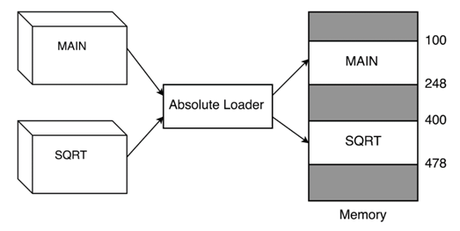
Absolute Loader

Slide 19
Absolute Loader
The starting address of every module is known to the programmer

Slide 20
Absolute Loader
The starting address of every module is known to the programmer
This corresponding starting address is stored in the object file

Slide 21
Absolute Loader
The starting address of every module is known to the programmer
This corresponding starting address is stored in the object file
Task of loader becomes very simple: To simply place the executable form of the machine instructions at the locations mentioned in the object file.

Slide 22
Absolute Loader
The starting address of every module is known to the programmer
This corresponding starting address is stored in the object file
Task of loader becomes very simple: To simply place the executable form of the machine instructions at the locations mentioned in the object file.
In this scheme, the programmer or assembler should have knowledge of memory management.

Slide 23
Absolute Loader
The starting address of every module is known to the programmer
This corresponding starting address is stored in the object file
Task of loader becomes very simple: To simply place the executable form of the machine instructions at the locations mentioned in the object file.
In this scheme, the programmer or assembler should have knowledge of memory management.
The resolution of external references or linking of different subroutines is the issues which need to be handled by the programmer. .

Slide 24
Absolute Loader
Simple to implement
Process of Execution is efficient
Multiple Programs are allowed
Multiple source languages can be used
Common object file will be prepared for multiple languages or multiple programs
Task of Loader is to load the object code in main memory at given address
Advantages

Slide 25
Absolute Loader
Programmer’s duty is to perform all linking activity and inter-segment addresses
Programmer must know memory management
Programmer need to update changes in starting address of modules if any modification is in source program
Disadvantages

Slide 26
Design of an Absolute Loader
The four loader functions are accomplished as follows:
Allocation – by Programmer
Linking – by Programmer
Relocation – by Assembler
Loading – by Loader

Slide 27
Design of an Absolute Loader
It is only necessary for the loader to read cards of the object deck and move the text on the cards into the absolute locations specified by the assembler.
There are two types of information that the object deck must communicate from the assembler to the loader:
First: It must convey the machine instructions that the assembler has created along with the assigned core locations.
Second: It must convey the entry point of the program, which is where the loader is to transfer control when all instructions arc loaded.

Slide 28
Design of an Absolute Loader
Text Cards (For instruction and Data)
Card Column | Contents
1 | Card type = 0 (for text card identifier)
2 | Count of number of bytes (1 byte per column) of information on card
3-5 | Addresses at which data on card is to be put
6-7 | Empty (could be used for validity checking)
8-72 | Instructions and data to be loaded
73-80 | Card sequence number

Slide 29
Design of an Absolute Loader
Transfer Cards (To hold entry point to program)
Card Column | Contents
1 | Card type = 1 (transfer card identifier)
2 | Count = 0
3-5 | Addresses of entry point
6-72 | Empty
73-80 | Card sequence number
1 | Card type = 1 (transfer card identifier)

Slide 30
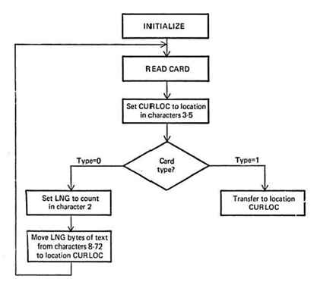
Design of an Absolute Loader
Algorithm
The object deck for this loader consists of a series of text cards terminated by a transfer card.
Therefore, the loader should read one card at a time, moving the text to the location specified on the card, until the transfer card is reached.
At this point, the assembled instructions are in core, and it is only necessary to transfer to the entry point specified on the transfer card..

Slide 31
Bootstrap Loader
Alternatively referred to as bootstrapping, bootloader, or boot program
Bootstrap loader is a program that resides in the computer's EPROM, ROM, or other non-volatile memory.
It is automatically executed by the processor when turning on the computer.
The bootstrap loader reads the hard drives boot sector to continue the process of loading the computer's operating system

Slide 32
Bootstrap Loader
The bootstrap loader is stored in the master boot record (MBR) on the computer's hard drive.
When the computer is turned on or restarted, it first performs the power-on self-test, also known as POST.
If the POST is successful and no issues are found, the bootstrap loader will load the operating system for the computer into memory.
The computer will then be able to quickly access, load, and run the operating system.

Slide 33
Bootstrap Loader
Function of Bootstrap Loader:
Enable the user to select the OS to start
Loading the OS file from the boot partition
Controls the OS selection process and hardware detection prior to kernel initialization.

Slide 37
Direct linking loader
A direct-linking loader is a general relocatable loader, and is perhaps the most popular loading scheme presently used
The direct-linking loader has the advantage of allowing the programmer multiple procedure segments and multiple data segments and of giving him complete freedom in referencing data or instructions contained in other segments.

Slide 38
Disadvantag
It is necessary to allocate, relocate, link, and load all of the subroutines each time in order to execute a program
Since there may be tens and often hundreds of subroutines involved, this loading process can be extremely time-consuming.
Furthermore, even though the loader program may be smaller than the assembler, it does absorb a considerable amount of space

Slide 39
Dynamic loading
If the total amount of core required by all the subroutines exceeds the amount available, then it is problem
There are several hardware techniques, such as paging and segmentation, that attempt to solve this problem;
For loaders: A scheme is applied which uses Binders

Slide 40
Loading process

Slide 41
Loading process
A binder is a program that performs the same functions as the direct-linking loader in "binding" subroutines together, but rather than placing the relocated and linked text directly into memory, it outputs the text as a file or card deck.
This output file is in a format ready to be loaded and is typically called a load module.
The module loader has to physically load the module into core.

Slide 42
Loading process

Slide 43
Dynamic loading
In each of the previous loader schemes we have assumed that all of the subroutines needed are loaded into core at the same time.
If the total amount of core required by all these subroutines exceeds the amount available, then it is a problem

Slide 44
Dynamic loading
There are several hardware techniques, such as paging and segmentation, that attempt to solve this problem
A dynamic loading schemes based upon the concept of a binder prior to loading can solve this problem

Slide 45
Dynamic loading
Usually the subroutines of a program are needed at different times
By explicitly recognizing which subroutines call other subroutines it is possible to produce an overlay structure that identifies mutually exclusive subroutines.

Slide 46
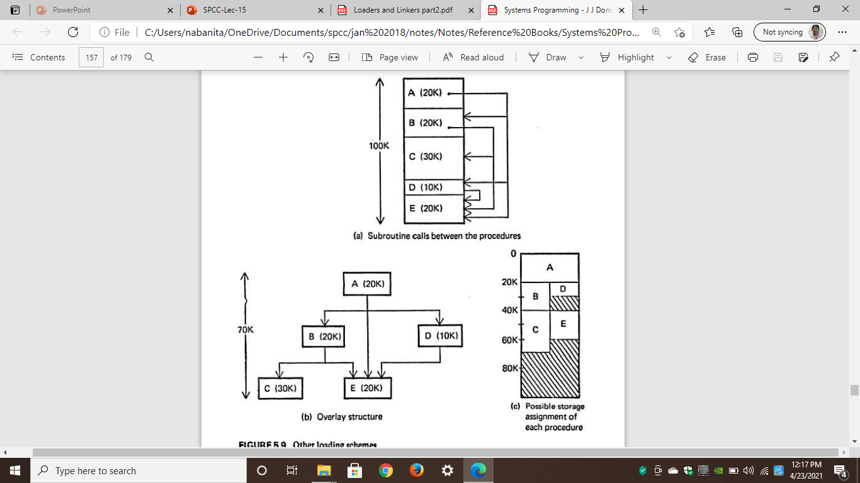
Dynamic loading

Slide 47
Dynamic loading
In the figure(a): A program consisting of five subprograms (A,B,C,D and E) that require lOOK bytes of core.
The arrows indicate that subprogram A only calls B, D and E
Subprogram B only calls C and E; subprogram D only calls E;
Subprograms C and E do not call any other routines.

Slide 48
Dynamic loading
In Figure 5 .9b the interdepencencies between the procedures are highlighted
Procedures B and D arc never in use at the same time; neither are C and E.
If we load only those procedures that are actually to be used at any particular time, the amount of core needed is equal to the longest path of the overlay structure.
This happens to be 70K for the example in Figure 5.9b - procedures A, B, and C.
Figure 5.9c illustrates a storage assignment for each procedure consistent with the overlay structure.

Slide 49
Overlay structure
In order for the overlay structure to work it is necessary for the module loader to load the various procedures as they are needed.
There are many binders capable of processing and allocating an overlay structure.
The portion of the loader that actually intercepts the "calls" and loads the necessary procedure is called the overlay supervisor or simply the flipper.
This overall scheme is called dynamic loading or load-on-call (LOCAL).

Slide 50
Disadvantage
If a subroutine is referenced but never executed, the loader would still incur the overhead of linking the subroutine.
Furthermore, all of these schemes require the programmer to explicitly name all procedures that might be called.

Slide 51
Dynamic linking
This is a mechanism by which loading and linking of external references are postponed until execution time.
The assembler produces text, binding, and relocation information from a source language deck.
The loader loads only the main program.

Slide 52
Dynamic linking
If the main program should execute a transfer instruction to an external address, or should reference an external variable, then the loader is called.
Only then is the segment containing the external reference is loaded.

Slide 53
advantage
No overhead is incurred unless the procedure to be called or referenced is actually used.
The system can be dynamically reconfigured.

Slide 54

Dynamic linking vs binders

